Slide 1
Session 7

Slide 2
Content of session
1
2
2D & 3D
Dive into 3D world
3
4
Character Controller
Assets

Slide 3
1
2D & 3D

Slide 4
Nodes

Slide 5
Nodes
Equivalent nodes:
Area2D -> Area3D
Camera2D -> Camera3D
Character body2D -> Character body3D
Collision Shape2D -> Collision shape3D
Audio Stream2D -> Audio Stream3D
Non-Equivalent nodes:
Timer
Animation Player

Slide 6
Position

Slide 7
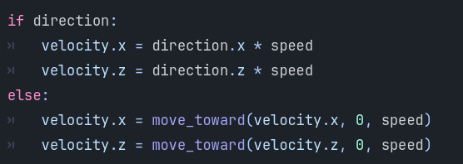
Position
Z-axis

Slide 8
Character Animation

Slide 9
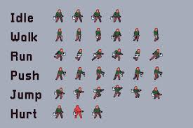
Character Animation
Images (Sprite Sheet)
❌

Slide 10
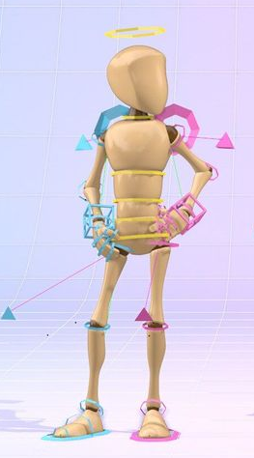
Character Animation
Models

Slide 11
Character Animation
Models contains:
Meshes : The 3D shape or geometry of an object made of vertices, edges and faces.
Textures : Image applied to a mesh’s surface to give it details (color, pattern)
Materials : Defines how meshes looks (color, texture, etc.)
Rig : The Skeleton or bone structure used for animating a 3D models
Animation : A sequence of movements or transformations applied to a model or its rig

Slide 12
2
Dive into 3D world

Slide 13
Controls

Slide 14
Controls
Action | shortcut
Rotate around object | Middle mouse
Pan (move view) | Shift + middle mouse
Move camera freely (fly mode) | Right mouse +WASDEQ
Move faster/slower in fly mode | Shift (faster)/Alt (slower)
Focus selected object | F
Change camera speed | Scroll wheel
Toggle local/global transform | T

Slide 15
Local and global transform

Slide 16
Local and global transform
Local mode: move object with the axes of the object itself.
Global mode: move object with the axes of the world object is in.

Slide 17
Grey Boxing

Slide 18
Grey Boxing
CSG Nodes: a node that allow you to make a complex shapes by combining shapes like cubes, spheres and cylinders. You can use this to make a prototype for the level you want make.

Slide 19
Grey Boxing
Importance:
Speed
Easy to focus on design
Testing gameplay
Easy changes

Slide 20
Grey Boxing
Types of CSG Nodes:
CSGBox: a box shape.
CSGCylinder: a cylinder shape.
CSGSphere: a sphere shape.
CSGPolygon: a polygon shape.
CSGMesh: a mesh shape.
CSGTorus: a torus shape.
CSGCombiner: a node that combines multiple CSG nodes into one shape.

Slide 21
Hands on

Slide 22
Where is the level??

Slide 23
We need:
Camera -> add camera3D for your scene.
Directional Light -> add Sun to your scene.
World Environment -> add environment.

Slide 24
3
Character Controller

Slide 25
Character Controller
What should It contain :
Camera -> FPS or TPS or move freely ?
Double jump ?
Wall jump ?
Shoot ?

Slide 26
4
Assets

Slide 27
Assets
Supported assets extension:
.FBX
.gltf -> best for godot
.glb -> binary version of gltf
.OBJ
.DAE
.blend -> blend files but should have blender installed

Slide 28
Assets
.gltf object include all of materials, texture inside it and can be extracted in separate files in addition to the object itself.

Slide 29
Thanks!
Any Questions

